Slide 1
Average Case Analysis
We need to know instance distribution
  Still have to model for some distribution
  Sometimes we make ideal assumption that all instances of any given sizes are equally distributed
    Randomize algorithms
Probabilistic Analysis for average-case or expect time

Slide 2
The hiring problem
You are to hire a new office assistant
A recruiter send you one out of n candidates each day
You interview the candidate being sent
  The interview cost is c_{i}, which is small
You fire current assistant and hire the candidate if he/she is the best so far
  The firing/hiring cost is c_{h}, which is high
You like to know the expect “cost” (not execution time here) of the hiring

Slide 3
The algorithm for the hiring problem
HIRE-ASSISTANT(n)
{
best = 0;
for (i=1; i<=n; i++) {
interview candidate i;
if (candidate i is better than candidate best) {
fire candidate best;
best = i;
hire candidate i;
}
}
}
cost c_{i}
cost c_{h}
What is the worst case cost? Best case?
What is the expected cost?

Slide 4
Probabilistic Analysis and Randomized Algorithm
Probabilistic analysis
  Use probability in the analysis
  Need to know to make assumption the distribution of inputs/instances
  Computing expected running time
    Averaging over all possible inputs
Randomized algorithm
  Randomize the input so the behavior of algorithm depends on the input as well as the random number generator

Slide 5
The randomized algorithm for the hiring problem
HIRE-ASSISTANT(n)
{
best = 0;
for (i=1; i<=n; i++) {
randomly to choose a candidate c to interview;
if (candidate c is better than candidate best) {
fire candidate best;
best = c;
hire candidate c;
}
}
}

Slide 6

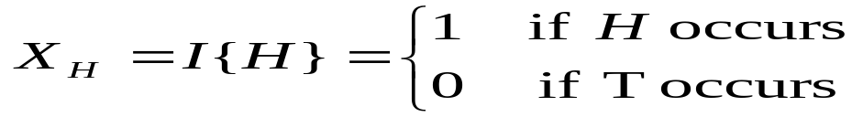
Indicator random variables
Given a sample space S and an event A. The indicator variable I{A} associated with event A is
Example: flip a fair coin. S = {H, T}.
  X_{H} (I{H}) is the indicator variable associate with the event H

Slide 7
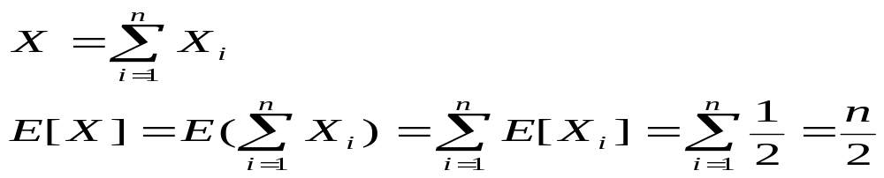
Expected value of indicator variable
Theorem:
  Given a sample space S and an event A, let X_{A}= I{A} Then E[X_{A}] = Pr{A}.
Example:
  X_{H} is the indicator variable associate with the event H (head)
  What is the expected number of heads in n coin flips
    Let X be the random variable denoting the total number of head in the n coin flips, X_{i} =I{the i_{th} flip results in the event H}

Slide 8
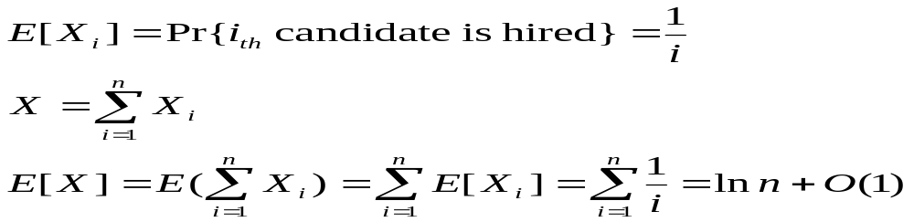
Analysis of the hiring problem
Let X be the random variable denoting the total number of times a new assistant is hired
X_{i} =I{the i_{th} candidate is hired}
Assuming that the candidates are presented in a random order, algorithm HIRE_ASSISTANT has a total hiring cost O(c_{h} ln n)

Slide 9
Insertion sort
Assume that
  all n! permutations of the array elements are equally likely
    Or we randomize the array in the beginning
  The n elements of the array are distinct
void insertionSort(int A[0..n-1])
{
int i, j, tmp;
for (i=1; i<n; i++) {
tmp=A[i];
j = i-1;
while (j>=0 && tmp<A[j]) {
A[j+1] = A[j];
j--;
}
A[j+1] = tmp;
}
}

Slide 10
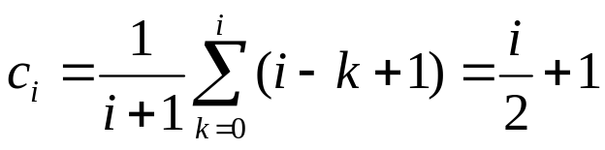
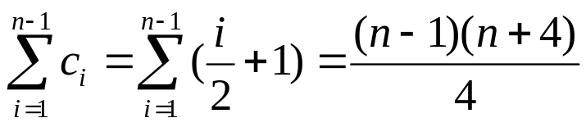
Average case analysis of insertion sort
Choose the while loop condition check as the barometer
Define the partial rank of A[i] be the position of A[i] if the sub array A[0..i] is sorted
  The partial rank of A[i] is equally likely to take any value between 0 and i
Note that A[0..i-1] is sorted. Let the partial rank of A[i] be k. The barometer executes i-k+1times. The average number of times of the test is
The total average is

Slide 11
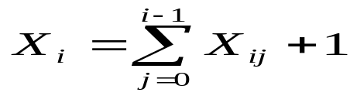
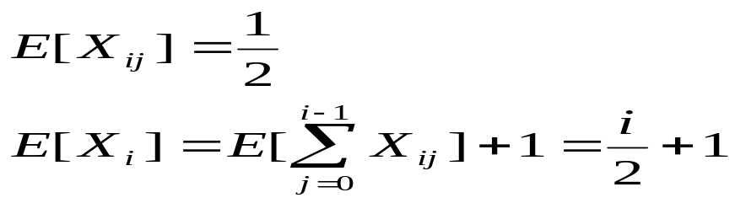
Analysis using indicator variable
Let X_{ij} be the indictor variable that associated with event A[i]<A[j]
Let X_{i} be the number of times of the test at iteration i (from 1 to n-1), we have

